Slide 1
Employee Data Analysis using Excel
STUDENT NAME :PRIYANKA R
REGISTER NO :312209333
NAAN MUDHALVAN ID :asunm1353312209333
DEPARTMENT :B.COM GENERAL
COLLEGE :ANNA ADARSH COLLEGE FOR WOMEN

Slide 2
PROJECT TITLE
Employee Performance Analysis using Excel

Slide 3


AGENDA
Problem Statement
Project Overview
End Users
Our Solution and Proposition
Dataset Description
Modelling Approach
Results and Discussion
Conclusion
3/21/2024 Annual Review

Slide 4

PROBLEM STATEMENT
Employee Performance Analyzer is designed to assess an employee’s current performance level.
It help the organisation to identify performance of various employee of various units.
When an employee exhibits low performance, the tool aids in identifying areas of concern and provides strategies to boost motivation and improve productivity.

Slide 5

PROJECT OVERVIEW
.
The project entails utilizing Excel to assess employee performance data, with a focus on essential metrics such as productivity, efficiency, and goal attainment.
This analysis will be presented through a PowerPoint, showcasing trends, strengths, and areas needing improvement within the organization.
The final presentation will offer actionable recommendations for improving employee performance.

Slide 6
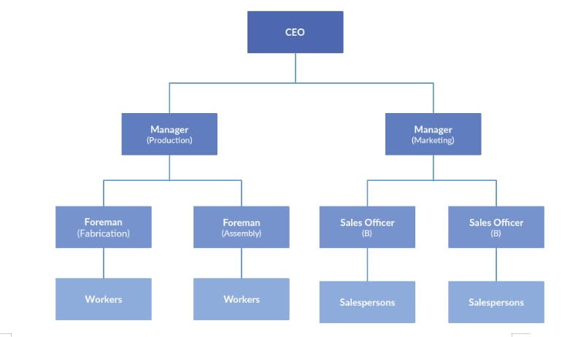

WHO ARE THE END USERS?

Slide 7

OUR SOLUTION AND ITS VALUE PROPOSITION
Using
Conditional formatting : Missing figure
Filter: Remove
Pivot: Summary
Graph: Data Visualization

Slide 8
CONDITIONAL FORMATTING
Title: Using Conditional Formatting to Detect Missing DataContent
Explanation: Explain how conditional formatting can be applied to detect missing data within your dataset
Example: Provide a screenshot or describe how cells with missing values are highlighted to quickly identify gaps in the data.
Purpose: Highlight the significance of this step in maintaining data quality prior to conducting further analysis.

Slide 9
FILTERING
Title: Filtering – Eliminating Unnecessary Data Content: -Explanation: Describe the filtering process employed to clean the dataset, including the removal of rows with missing values or irrelevant columns. - Steps: Detail: the criteria used for filtering, such as rows with null values in key columns. -Tools: Identify the tools or functions used for filtering, such as Excel’s filter function method. -Outcome:Specify the outcome of the filtering process, such as the number of rows or columns eliminated.

Slide 10
GRAPH
Title: Graphs – Visualizing Data Insights
Content:
Explanation: Explore the importance of graphs in visualizing data to effectively communicate insights
Types of Graphs:
Bar Chart: Explain how a bar chart can illustrate performance levels across different departments
Other Visuals: Reference other types of charts used, such as pie charts and line graphs
Purpose: Emphasize how these visualizations aid in understanding data distribution and identifying trends.

Slide 11
PIVOT TABLE
Title: Pivot Table – Analyzing Employee Performance
Explanation: Present the pivot table as a powerful tool for summarizing and analyzing employee performance data
Steps
Creating the Pivot Table: Provide a concise overview of how to create a pivot table, including selecting fields and organizing the data
Performance Metrics: Describe the performance metrics summarized in the pivot table, such as average performance scores by department.
Visual Example: Include a screenshot of the pivot table or give a detailed description of its layout.

Slide 12
Dataset Description
EMPLOYEE=KAGGLE
26-FEATURES
9-FEATURES
EMPLOYEE ID-NUM
NAME-TEXT
EMPLOYEE TYPE-TEXT
PERFORMANCE SCORE-NUM
GENDER-MALE,FEMALE
EMPLOYEE RATING -NUM

Slide 13

THE "WOW" IN OUR SOLUTION
PERFORMANCE=IFS(Z8>=5,”VERY HIGH”,Z8>=4,”HIGH”,Z8>=3,”MED”,TRUE,”LOW”
3/21/2024 Annual Review
13

Slide 14
MODELLING
1.Data Collection
a)Downloaded from the Edunet Dashboard.
b)Gathered the employee performance score
2.Feature Collection:
a)Identified performance levels.
b)Removed blank columns.
3.Performance Levels:
a)Determined performance scores using formulas.
b)Defined them using a pivot table.
14

Slide 15
4.Summary:
a)Downloaded the employee dataset from the dashboard and deleted blank columns.
b)Created performance levels using formulas.
c)Defined them with a pivot table.

Slide 16
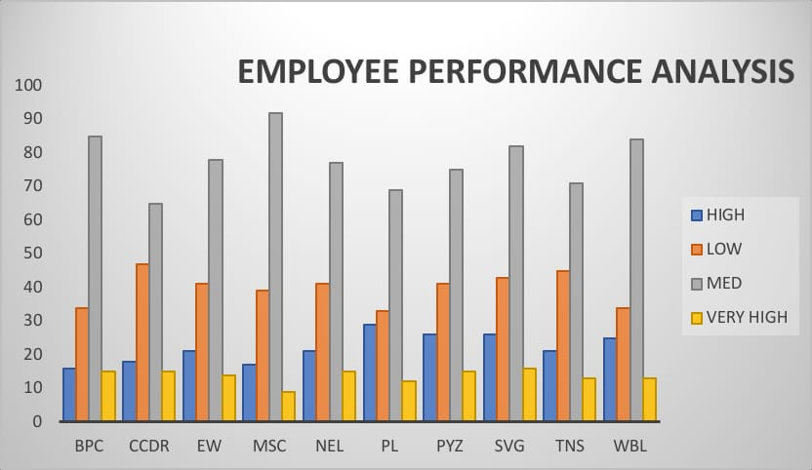
RESULTS
16

Slide 17
CONCLUSION
The employee dataset, as analyzed by me using Excel, shows that the organization is performing well overall. While most employees exhibit good performance, a few need improvement. To help them develop, additional tasks can be assigned. This conclusion highlights the key findings from the dataset.

